Slide 1
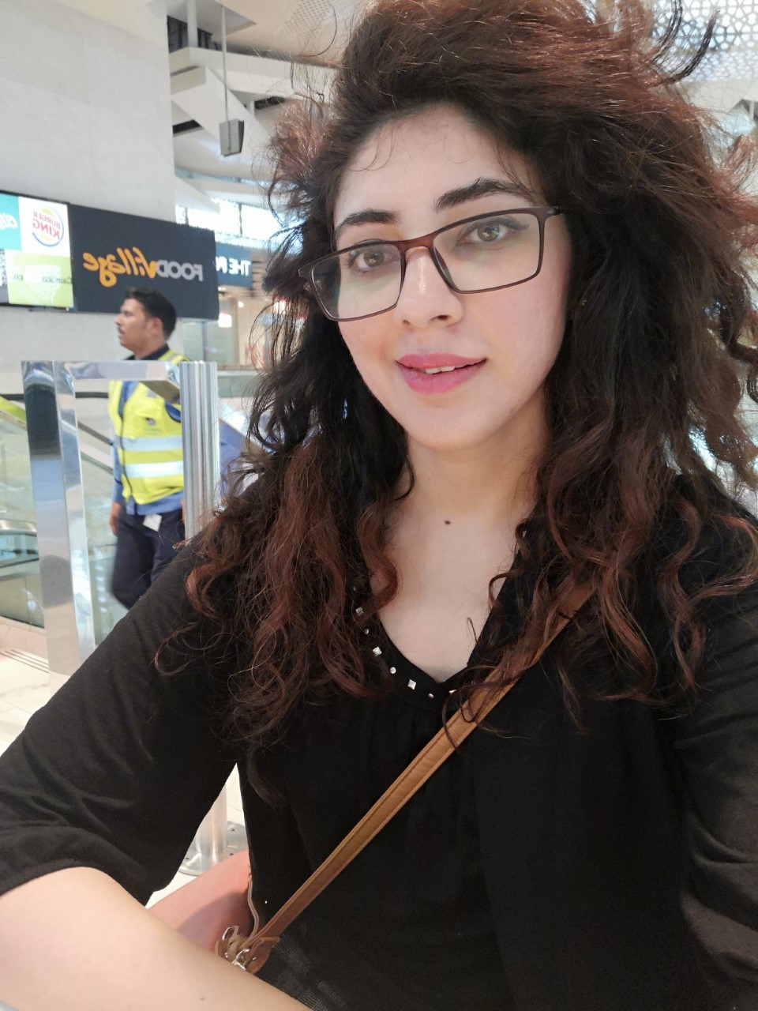
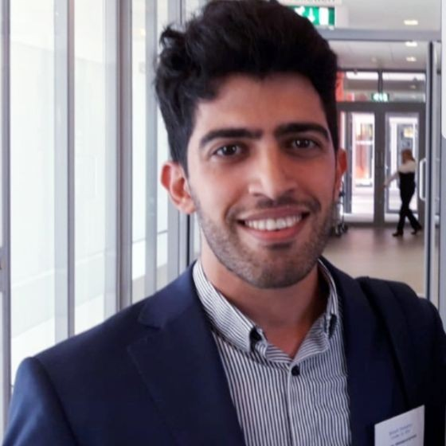

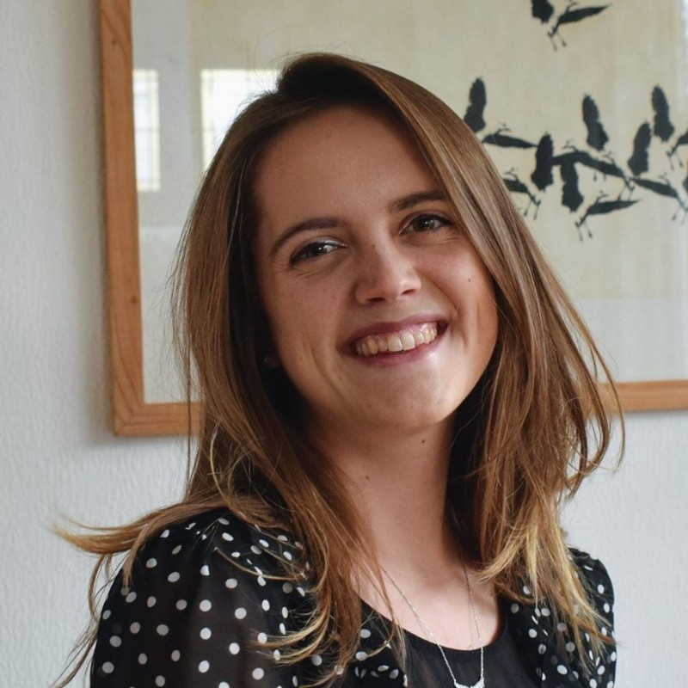
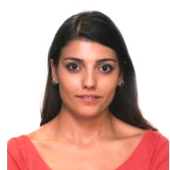
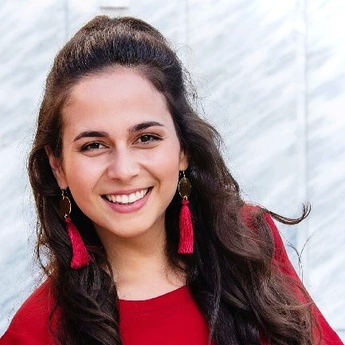
Aneesa Abouzar Zeynab
Eelke Simay Angeliki
Notes:
We are a group of six pdeng trainees or data scientists from different generations who decided to team up and partipated In the hackathon held on from 3-5April.

Slide 2


Notes:
Something about the hackathon. 52 teams. Four categories: Healthcare and well being , remote education, sme business continuity , logistics and supply chain.
How can the medical equipment manufacturers use the data regarding the number and distribution of patients in different countries in order to adapt their supply chains and transportation mechanisms?
Medical equipment is key in dealing with the current situation. As there is a shortage of medical equipment, many manufacturers have dedicated production lines to produce these equipment. However, this does not guarantee that the shortage issue is fairly answered across the globe (we have all heard some not nice news about medical aid not arriving at their final destination…) The use of AI could aid in determining the future number of patients in different countries and predict the number of required medical equipment. This data can be used by manufacturers to have an idea on how many equipment is needed. Afterwards, through transportation, the medical equipment could be sent to the target countries.This solution could ensure that every human’s life is treated equally. In addition, it can reduce the tension and stress on medical staff and allow them to concentrate on treating patients. Finally, by bringing different industries together, new business opportunities could be created. The challenge is then how can such a solution be realized? For this challenge the following specialists are required: 1. Medical staff 2. AI 3. Mathematic 4. Logistics 5. Transportation 6. Product design

Slide 3





1. Problem
1.36 Million
LCH

Slide 4


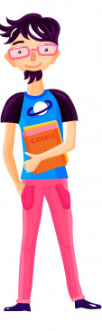

I can
help!
LCH

Slide 5
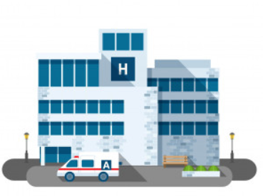

LCH
DEMAND
OFFERS
SOTI

Slide 6
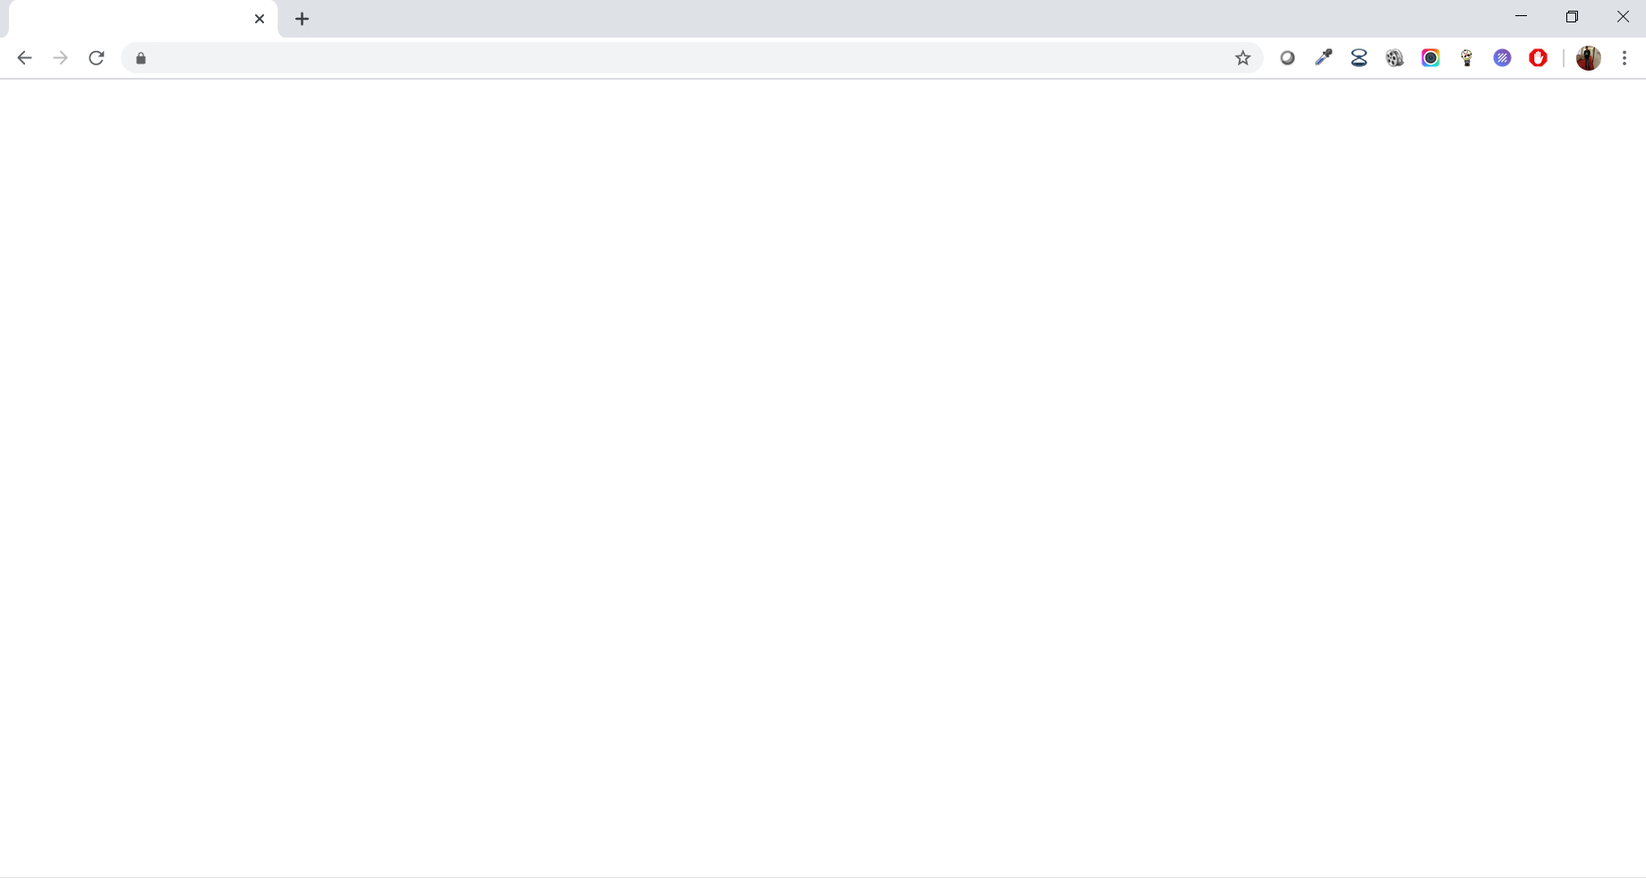
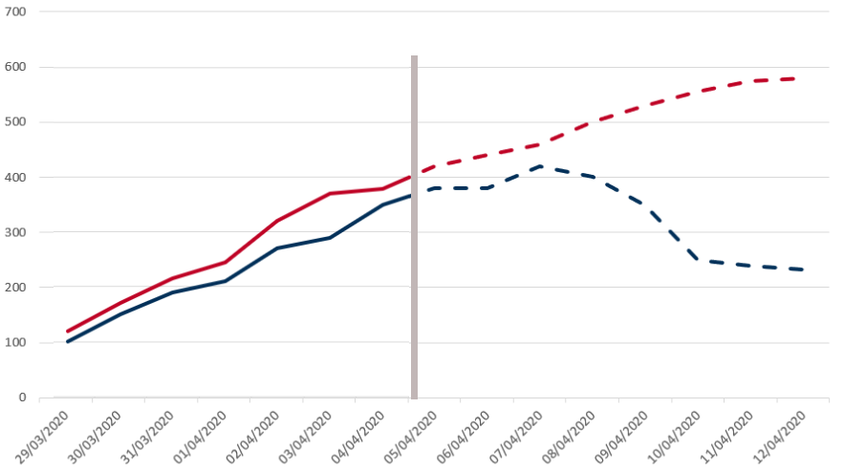
Hospital A
Number of masks needed
Hospital B
DEMAND
Past

Slide 7
Hospital A
Number of masks needed
Hospital B
DEMAND
Past
Future

Slide 8
Hospital A
Number of masks needed
Hospital B
DEMAND
Past
Future

Slide 9

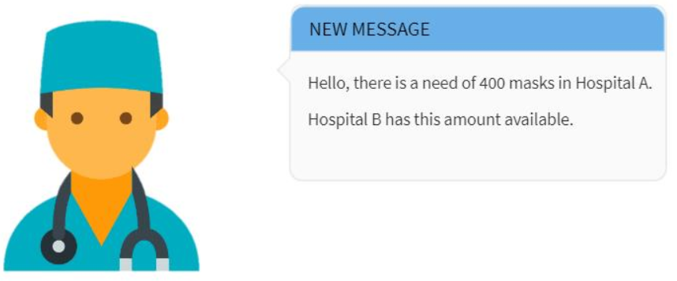
Hospital A
Number of masks needed
Hospital B
DEMAND
Past
Future

Slide 10

I can
help!
OFFERS

Slide 11

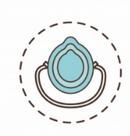

E- Tender
LCH
OFFERS

Slide 12
WHY SOTI?
Early intervention through predictive model
Involves small businesses
Integrates three main parties and thousands of people

Slide 13

SOTI connects them all
LCH

